Slide 1
Windows Forms and Basic Controls

Slide 2
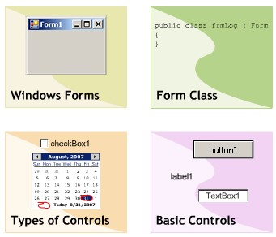
Objectives
In this module, you will learn about:
Windows Forms
“Form” class
Types of Controls
Basic Controls
Value Setting Controls
Selection List Controls
Grouping Controls
Graphic Controls

Slide 3
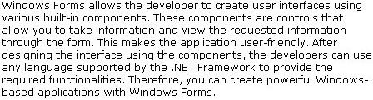
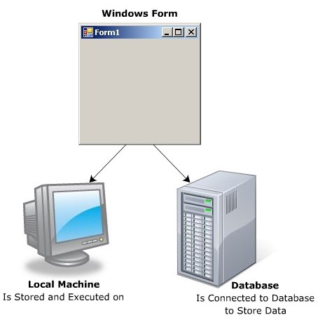
Windows Forms

Slide 4
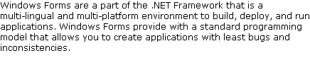
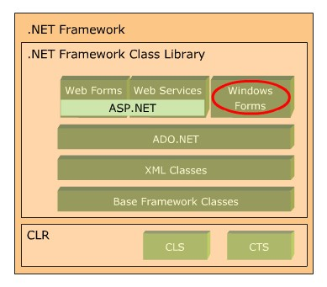
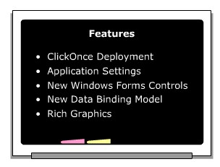
Windows Forms

Slide 5
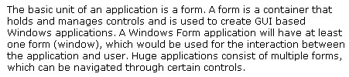
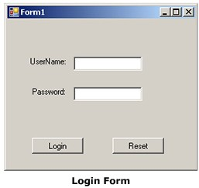
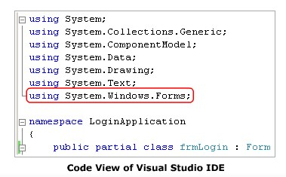
“Form” Class

Slide 6
Properties, Methods, Events
Properties
Name
Text
StartPosition
WindowState
FormBorderStyle
MinimizeBox
MaximizeBox
Icon
ShowInTaskbar
Methods
Show()
ShowDialog()
Focus()
Hide()
Close()
Events
Load
Shown
FormClosing

Slide 7
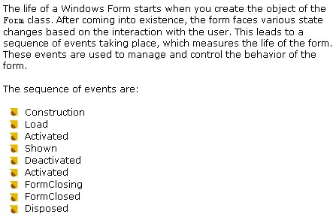
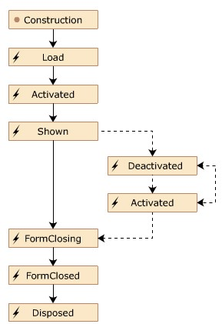
Lifecycle of “Form” Class

Slide 8
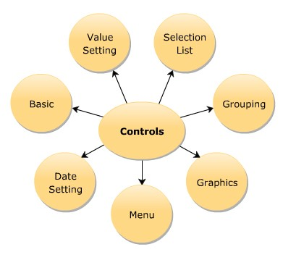
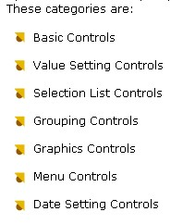
Types of Controls

Slide 9
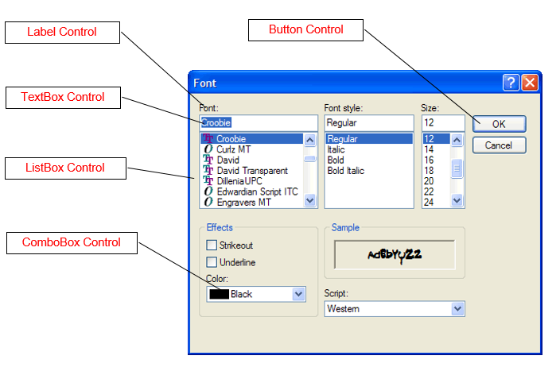
Types of Controls
Basic Controls

Slide 10
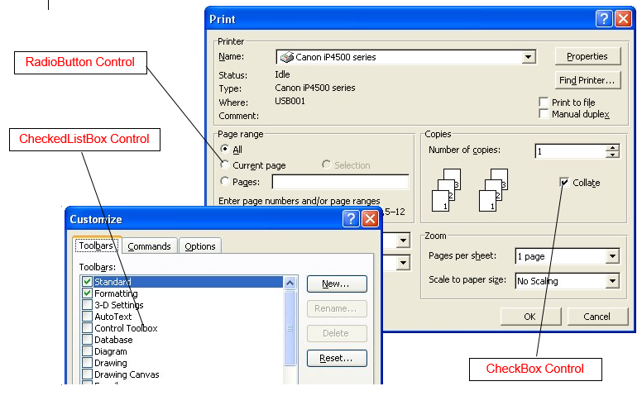
Types of Controls
Value Setting Controls

Slide 11
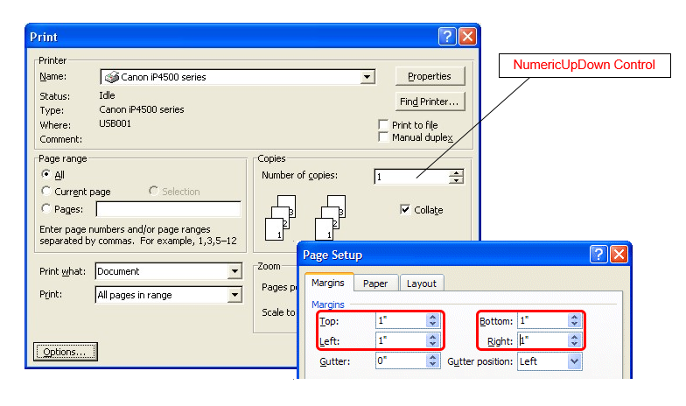
Types of Controls
Selection List Controls

Slide 12
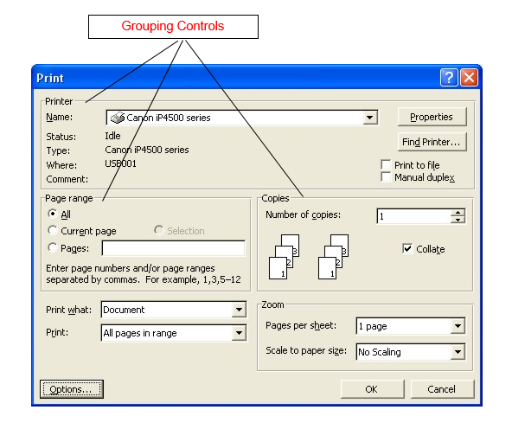
Types of Controls
Grouping Controls

Slide 13
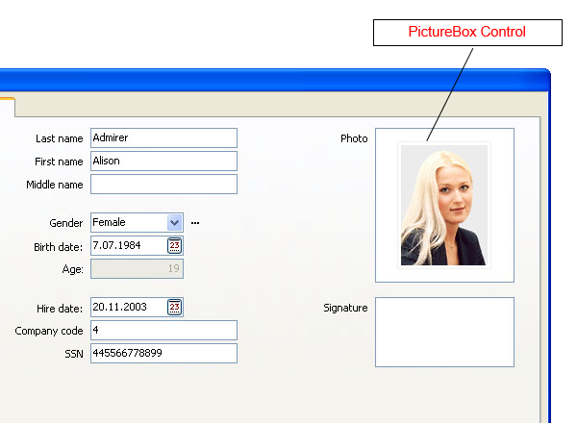
Types of Controls
Graphic Controls

Slide 14
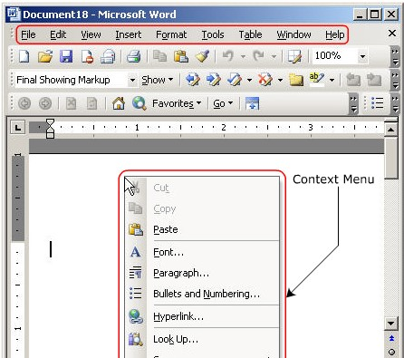
Types of Controls
Menu Controls

Slide 15
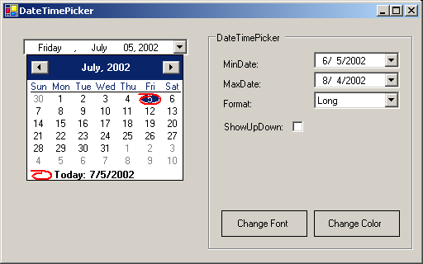
Types of Controls
Date Setting Controls

Slide 16
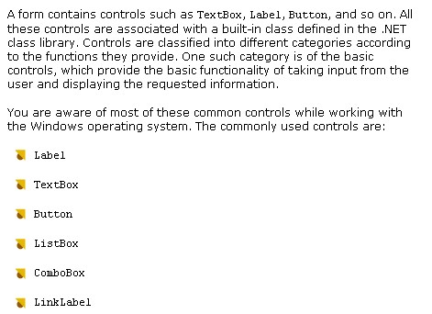
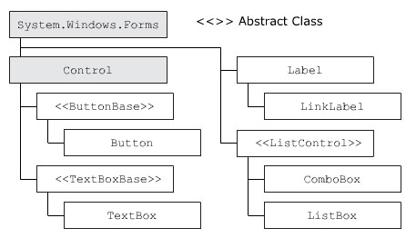
Basic Controls

Slide 17
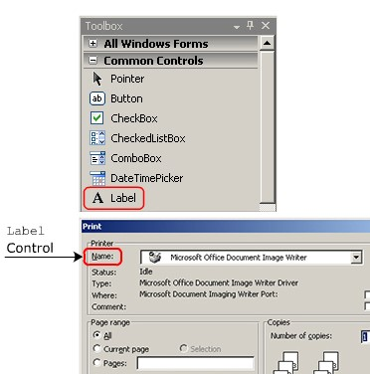
Label Control
The Label control is a control that is used to show detailed information, which cannot be modified by the user.
Syntax:
Label <objectName> = new Label();

Slide 18
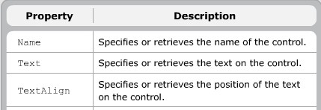
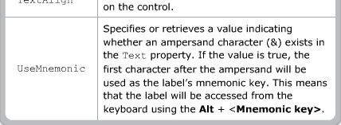
Label Control

Slide 19
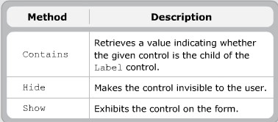
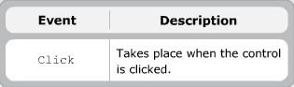
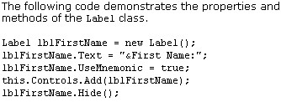
Label Control

Slide 20
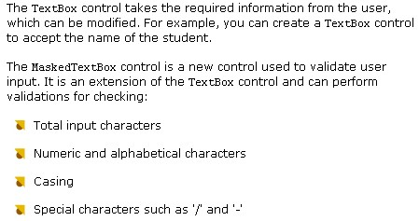
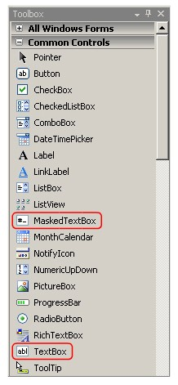
TextBox & MaskedTextBox Controls

Slide 21
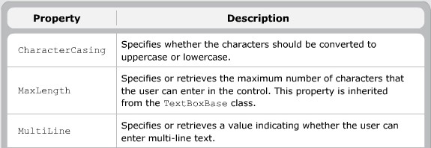
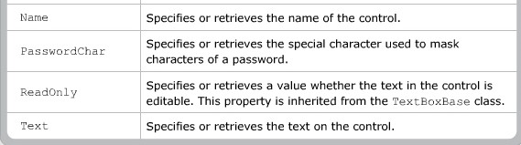
TextBox Control

Slide 22
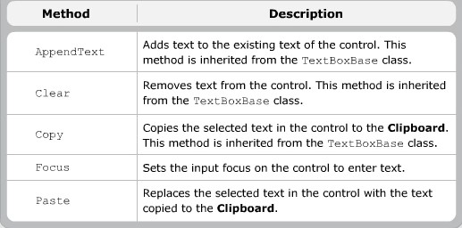
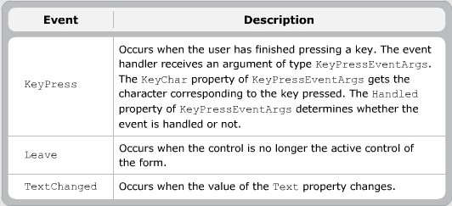
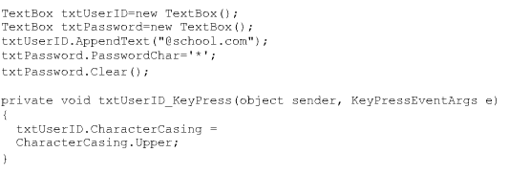
TextBox Control

Slide 23
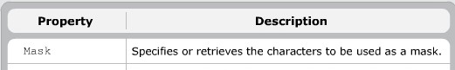
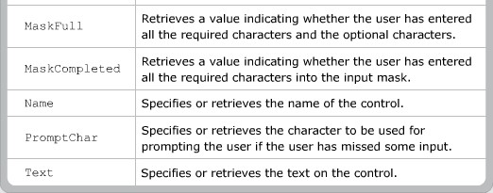
MaskedTextBox Control

Slide 24
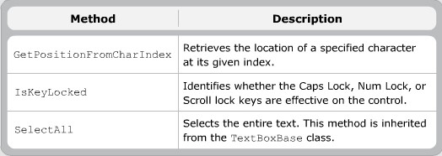
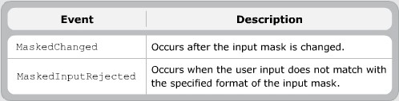
MaskedTextBox Control

Slide 25
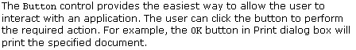
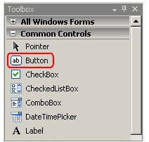
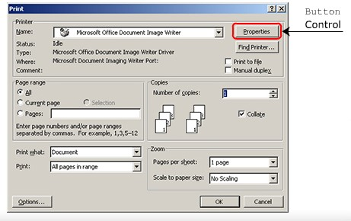
Button Control

Slide 26
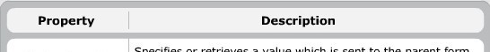
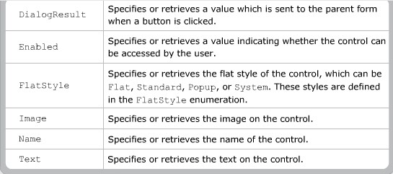
Button Control

Slide 27
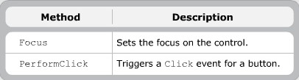
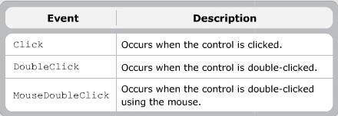
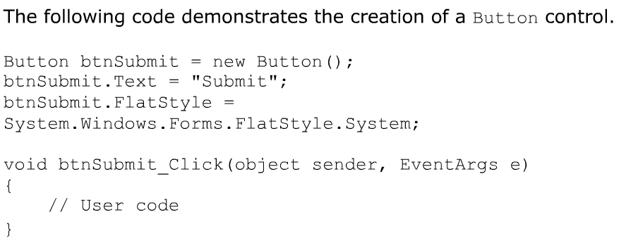
Button Control

Slide 28
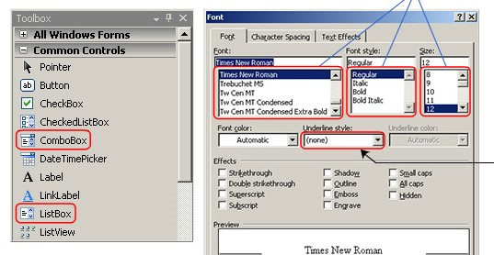
ListBox & ComboBox Controls
The ListBox control is a control used to select a single value or multiple values from the given list of values.
The ComboBox control is similar to the ListBox control, but it allows you to select only one value at a time.

Slide 29
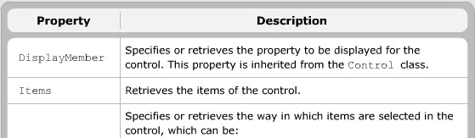
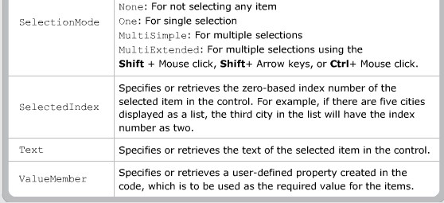
ListBox Control

Slide 30


ListBox Control

Slide 31


ComboBox Control

Slide 32


ComboBox Control

Slide 33


Value Setting Controls

Slide 34


RadioButton Control
The RadioButton control allows the user to select a single value from the given set of values.

Slide 35

RadioButton Control

Slide 36


RadioButton Control

Slide 37


CheckBox Control
The CheckBox control allows you to accept multiple values from a list of values.

Slide 38

CheckBox Control

Slide 39


CheckBox Control

Slide 40

CheckedListBox Control
The CheckedListBox control is a combination of the ListBox and CheckBox controls and is used to select multiple values from a list of values.

Slide 41


CheckedListBox Control

Slide 42


CheckedListBox Control

Slide 43

CheckedListBox Control

Slide 44


Selection List Controls

Slide 45

NumericUpDown Control
Allows you to select numeric values from a range of values
Select only a single values of a time

Slide 46


NumericUpDown Control

Slide 47



NumericUpDown Control

Slide 48



DomainUpDown Control
Allows you to select text values from a range of values
Select only a single values of a time

Slide 49

DomainUpDown Control

Slide 50


Grouping Controls

Slide 51


Panel Control

Slide 52


Panel Control

Slide 53


Panel Control

Slide 54



GroupBox Control

Slide 55

GroupBox Control

Slide 56


GroupBox Control

Slide 57

TabControl

Slide 58


Graphic Controls

Slide 59



PictureBox Control

Slide 60


PictureBox Control

Slide 61


PictureBox Control

Slide 62


ImageList Component

